Slide 1

BOOLEAN
TRUE
FALSE

Slide 2
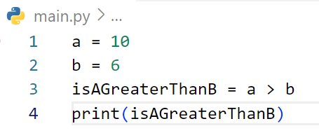
Find output of the code?

Slide 3
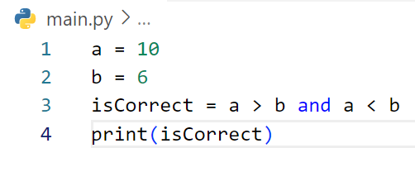
Find output of the code?

Slide 4
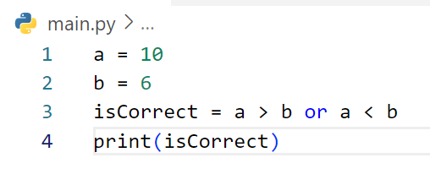
Find output of the code?

Slide 5
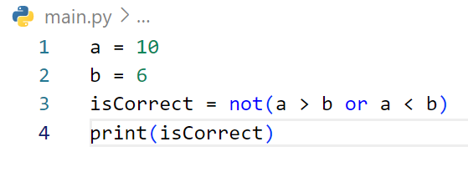
Find output of the code?

Slide 6
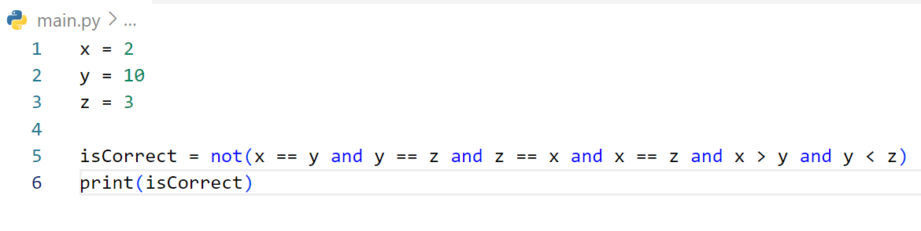
Find output of the code?

Slide 7
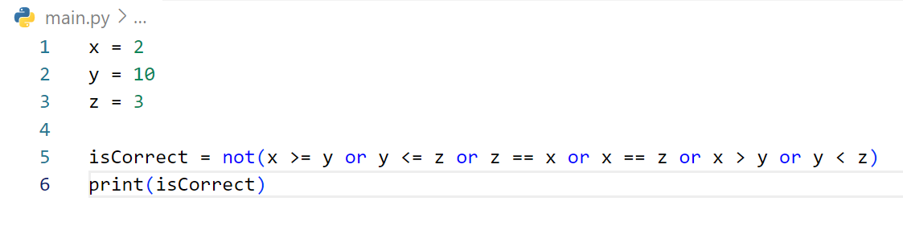
Find output of the code?

Slide 8
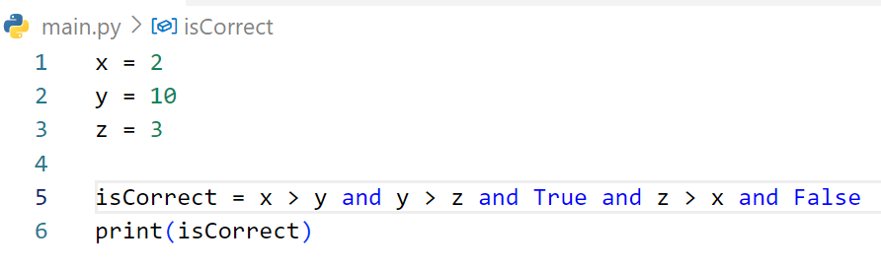
Find output of the code?

Slide 9
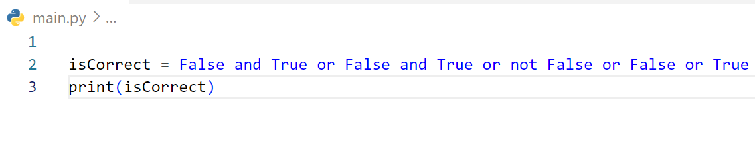
Find output of the code?

Slide 10
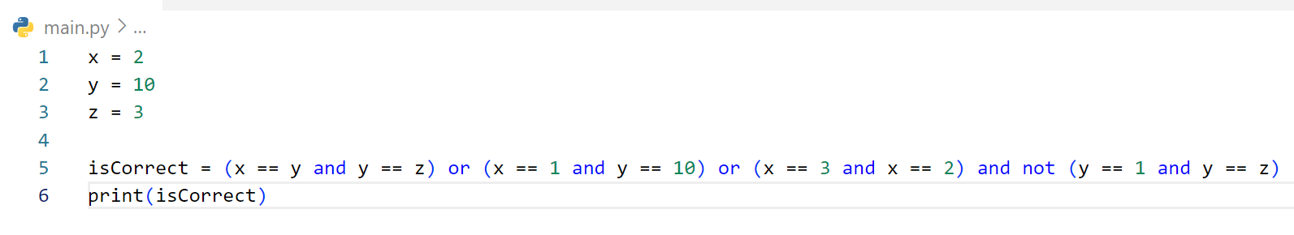
Find output of the code?

Slide 11
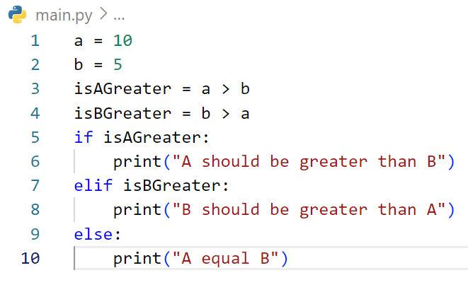
Find output of the code?

Slide 12
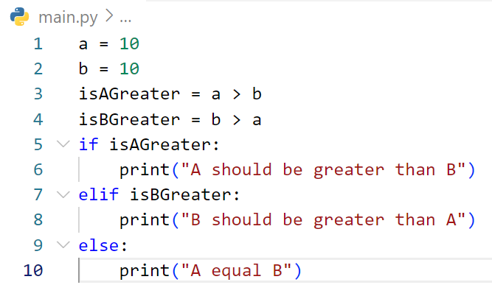
Find output of the code?

Slide 13
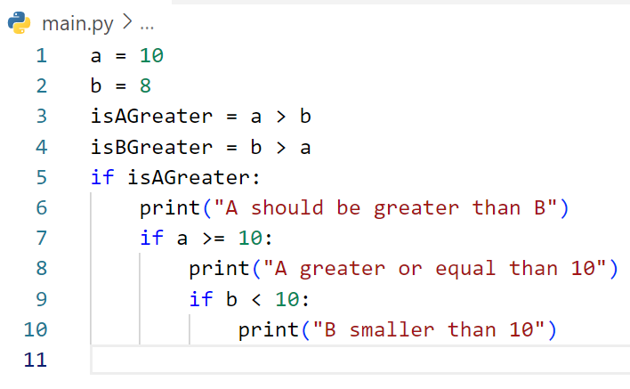
Find output of the code?

Slide 14
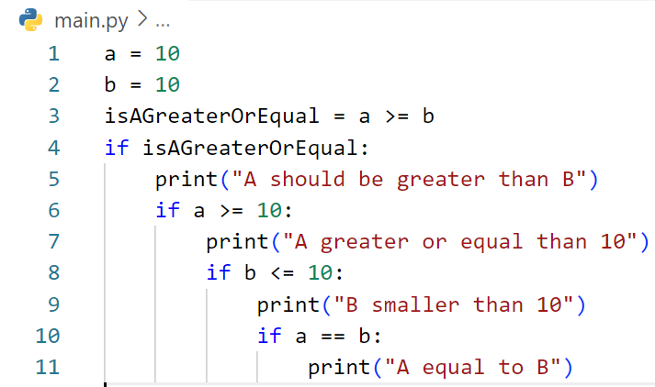
Find output of the code?

Slide 15
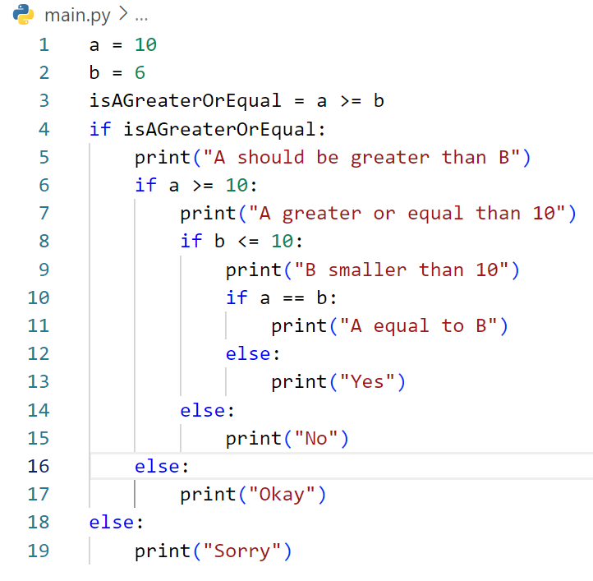
Find output of the code?

Slide 16
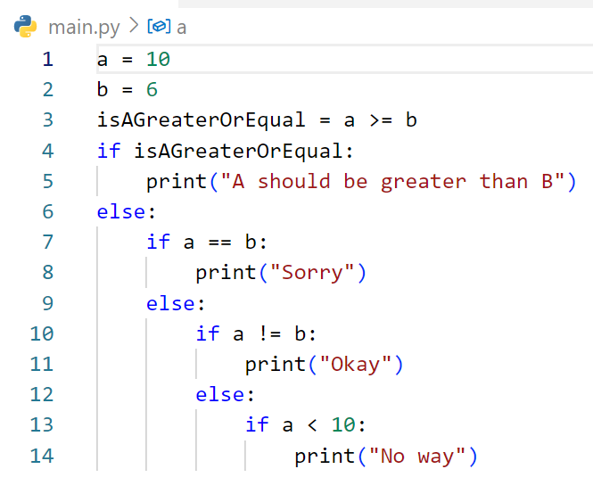
Find output of the code?

Slide 17
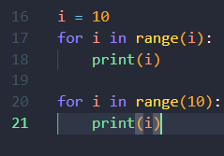
Write code to display number from 0 - 9?

Slide 18

Write code to display only even number from 0-100

Slide 19

Write code to display only odd number from 0-100

Slide 20
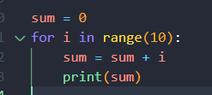
Write code to display sum number from 0-10

Slide 21
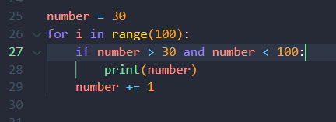
Write code to display only number are greater than 30 from 0-100

Slide 22
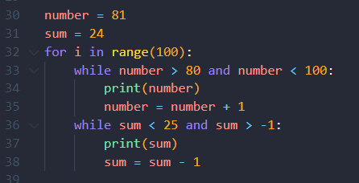
Write code to display only number are greater than 80 and
Less than 25 from 0-100

Slide 23
Write code to display only number are greater than 80 and
Less than 25 from 0-100

Slide 24
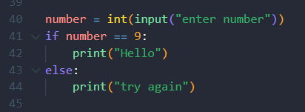
Write code to display “Hello” only when
I enter number 9 otherwise display try again!

